Slide 1

M&L
DISASTER RECOVERY EXPERIENCE
by Doug Skinner

Slide 2

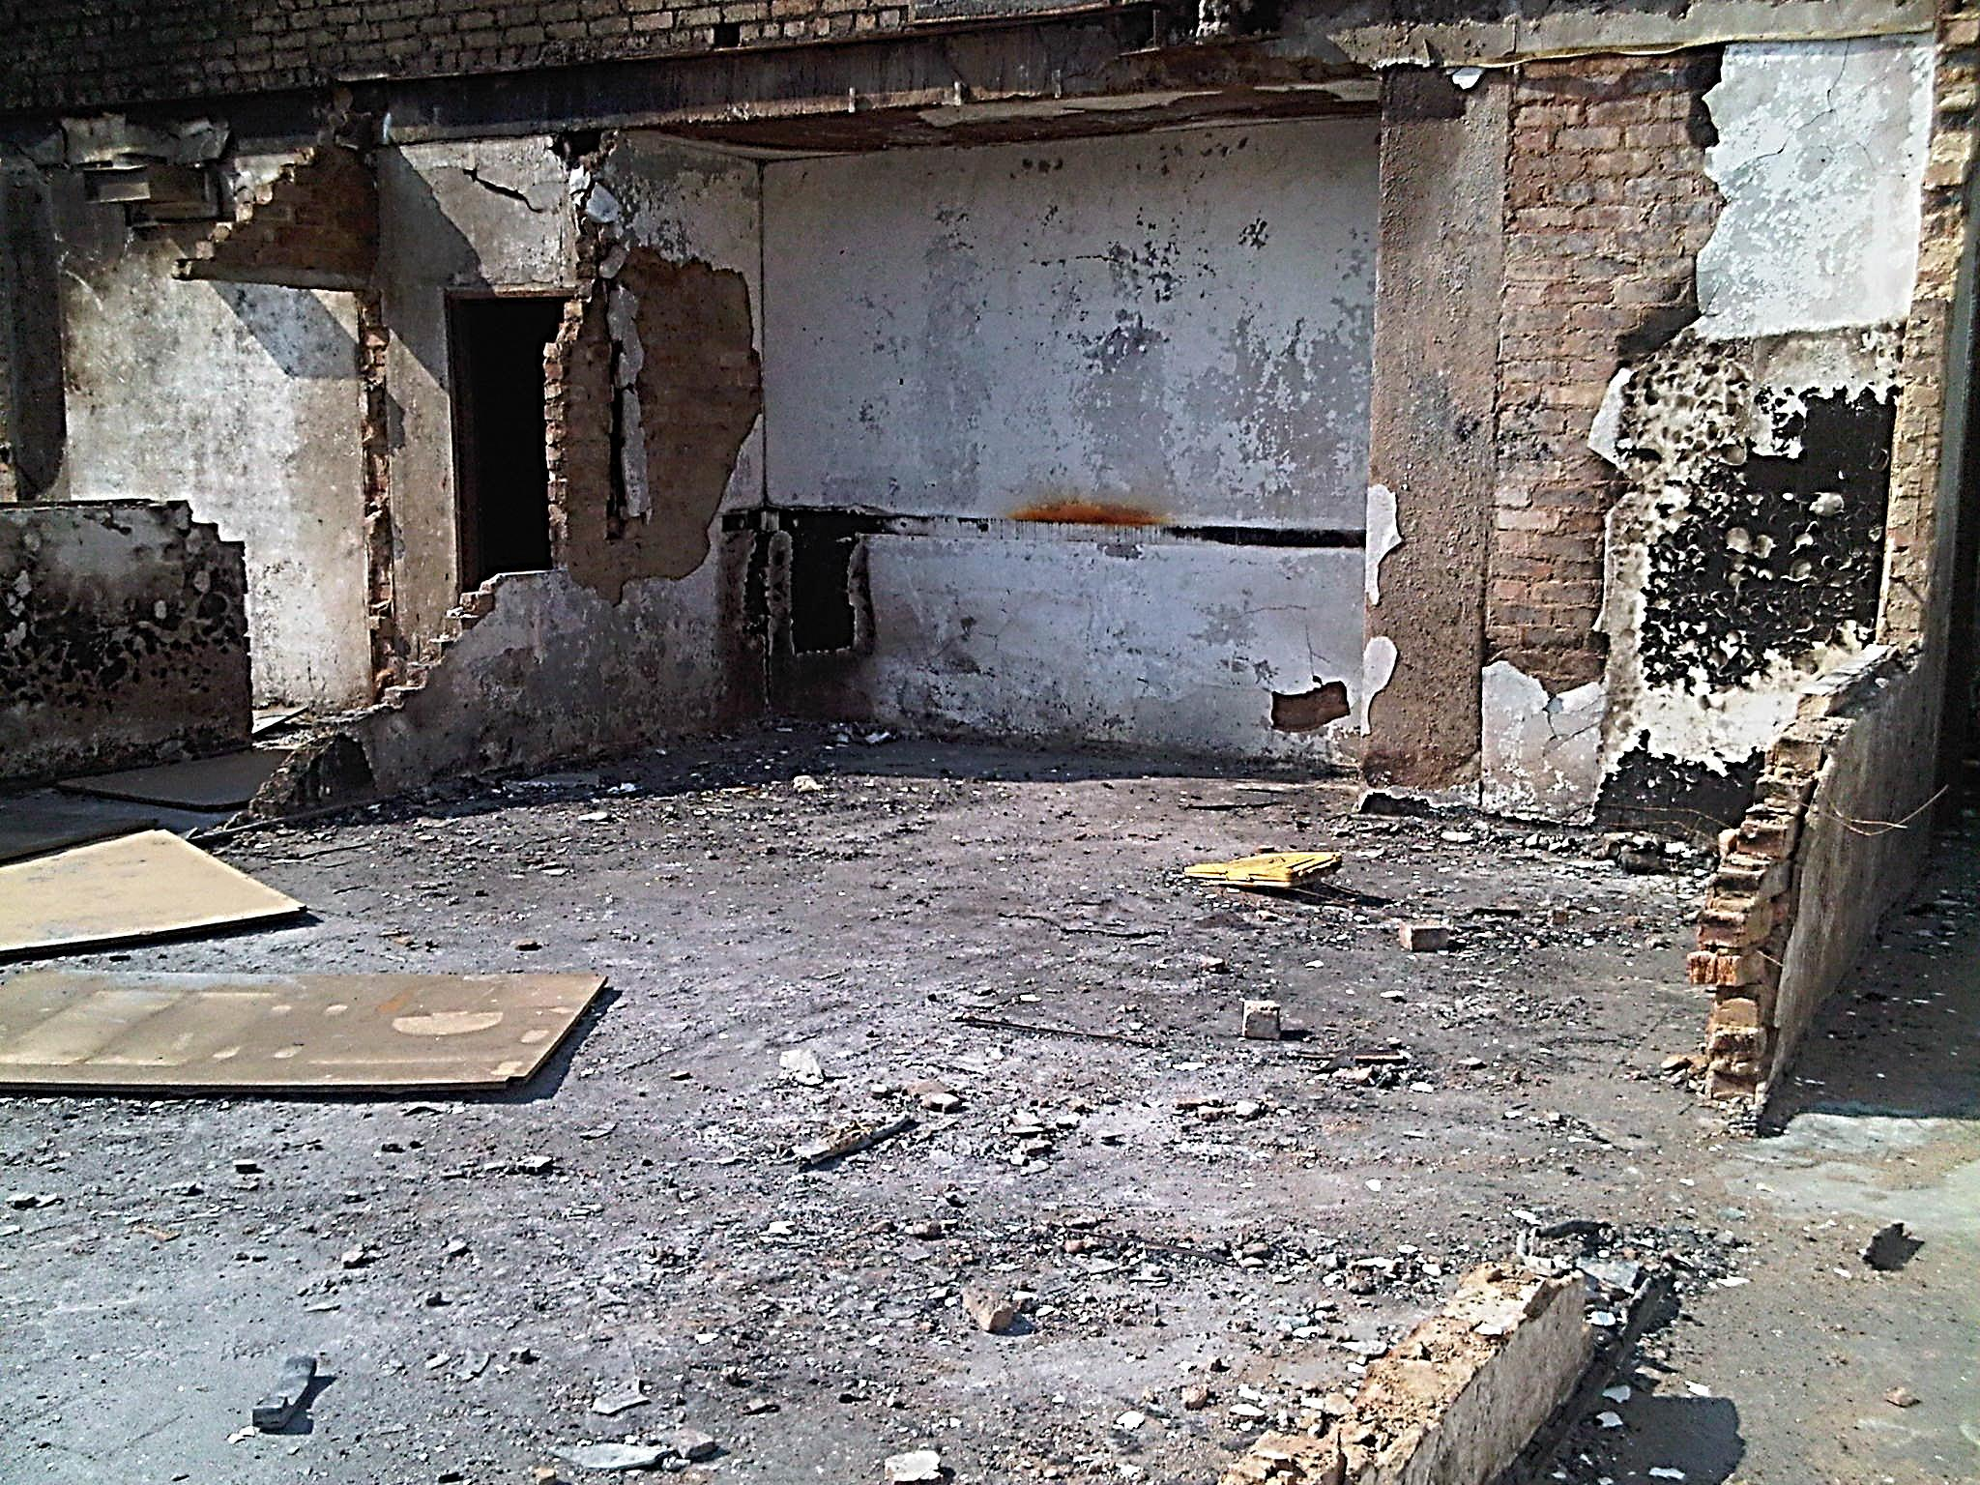
GONE FROM THIS

Slide 3


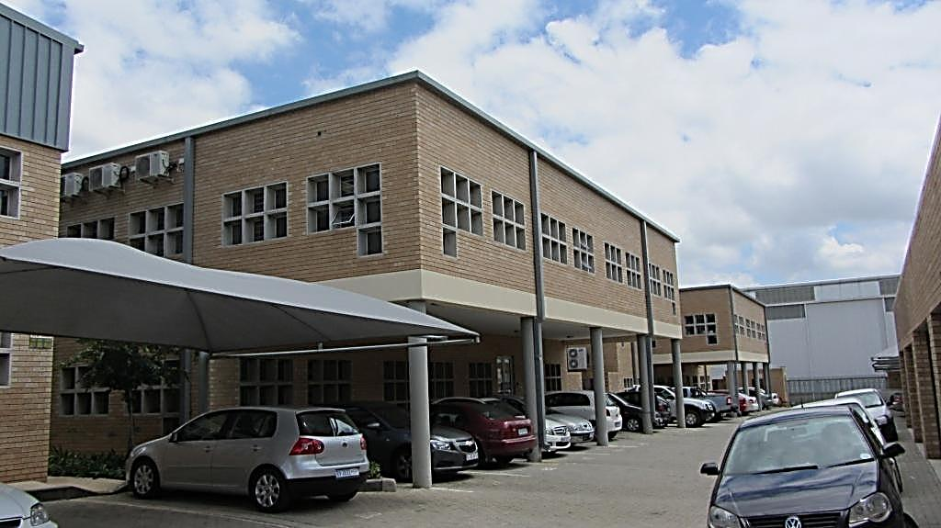
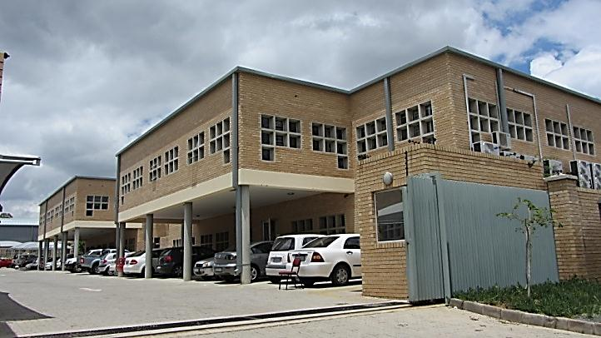
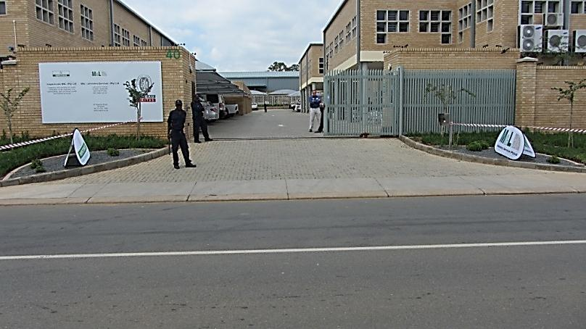
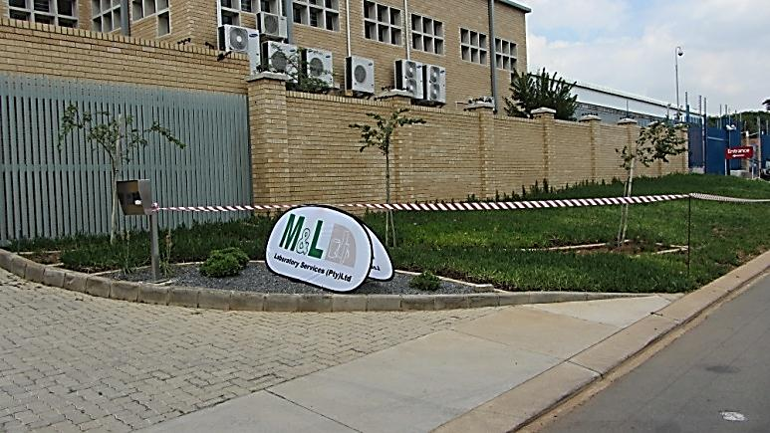
TO THIS, IN SIX MONTHS

Slide 4
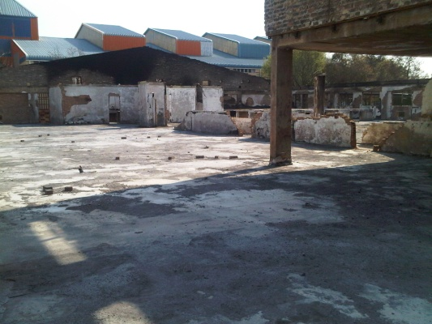
BACKGROUND
M & L laboratory services laboratory in Ormonde Johannesburg was severely damaged by fire on Tuesday 14 June 2011.
This resulted in extensive damage to the building and infrastructure.
It was therefore impossible to carry out any testing of customer supplied samples at the old MCC licensed facility.

Slide 5
BUSINESS CONTINUITY PLAN
DID A BCP EXIST ?
DID WE FOLLOW IT TO THE LETTER?
WHAT DID WE DO?

Slide 6
Bureau Veritas
(France)
Inspectorate Chemtaur (Pty) Ltd
Chemtaur Staff Trust
Private Shareholder
Inspectorate M&L (Pty) Ltd
M&L Laboratory Services (Pty) Ltd
Inspectorate Metals & Minerals (Pty) Ltd
Inspectorate Marine (Pty) Ltd

Slide 7
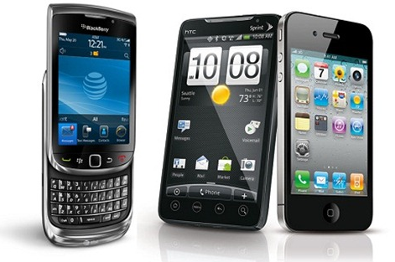
BUSINESS CONTINUITY PLAN
COMMUNICATION.
The first step in our BCP was to advise customers and regulators of the disaster and what our short term to medium term plans were.
This was carried out using mobile phones ,e-mail and personal visits to key customers / MCC /SANAS.

Slide 8
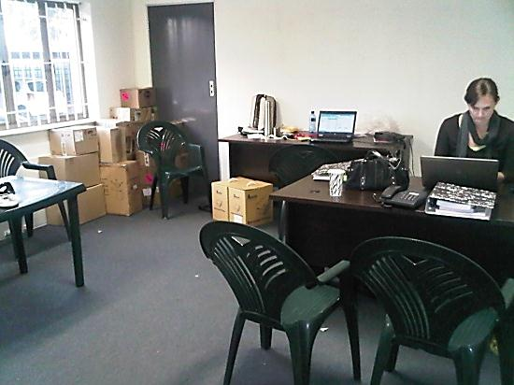
BUSINESS CONTINUITY PLAN
TEMPORARY OFFICES SPACE.
Temporary office space needed to be identified for head office and management staff.
The group fortunately managed to secure premises right next door to the then current lab.
All internet, email and telephone lines were re-routed.
The temporary office was then used as the company’s head office until the move to the new premises was ready.

Slide 9
BUSINESS CONTINUITY PLAN
TEMPORARY LABORATORIES.
New location and plans for the testing needed to be identified:
  Water lab - A SANAS accredited partner lab was used in the interim period.
  Environmental and occupational health labs - partnering with labs in South Africa and utilising M&L staff, samples were analysed according to M&L and EPA/NIOSH methodology
  Microbiological lab – M&L satellite laboratory with the assistance of Labotec was established in Midrand.
  Pharmaceutical lab M&L satellite laboratory with the assistance of Microsep, was established in Linbro business park.

Slide 10
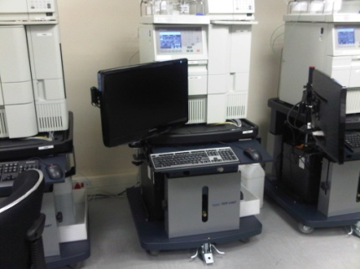
BUSINESS CONTINUITY PLAN
PHARMACEUTICAL LAB M&L SATELLITE LABORATORY
Major Equipment :
10X new HLPCs from Microsep linked into Empower software
2X Mill Q water purification systems
2X Analytical Balance
1X Top Load Balance
1XIR Spectrophotometer
1X UV/Vis Spectrophotometer
1X Gas Chromatograph
1XpH Meter
Other general lab Equipment (i.e. Vacuum pumps Glassware )
All of this equipment was subject to full IQ OQ and PQ qualification at the Microsep site)

Slide 11
BUSINESS CONTINUITY PLAN
PHARMACEUTICAL LAB M&L SATELLITE LABORATORY
A Risk Assessment was carried out and a low to no risk rating was identified:
This was based on the following:-
The equipment to be used is exactly the same as that used at M&L.
The Electronic data capture system is exactly the same as that used at M&L.
The electronic test methods will be electronically transferred from the M&L data base and are therefore an exact copy of current methods.
The analysts performing the testing are trained and competent in the use of the equipment and test procedures.
The reference standards are the same as supplied and used at M&L
The reagent, chemicals and solvents are the same grade and manufactured by the same suppliers.
SOPs used at M&L (i.e. OOS investigations Corrective Actions, customer complaints, etc) are not going to change and all relevant staff are familiar with them.

Slide 12
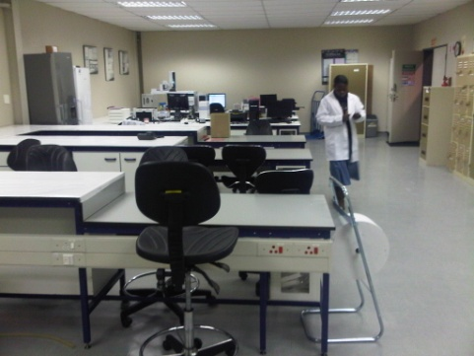
BUSINESS CONTINUITY PLAN
PHARMACEUTICAL LAB M&L SATELLITE LABORATORY
Application for Linbro site licence submitted , 23 June 2011
MCC inspection carried out 2nd and 3rd August 2011
M&L Response to findings submitted 7th September 2011
MCC licence issued 21st October 2011

Slide 13
BUSINESS CONTINUITY PLAN
PHASE 2

Slide 14
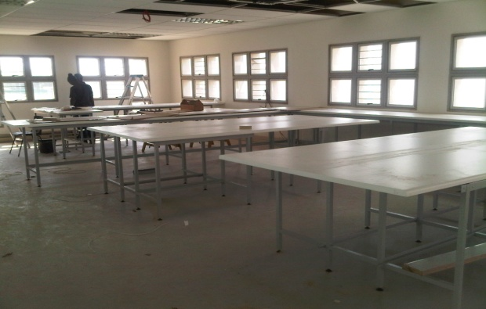
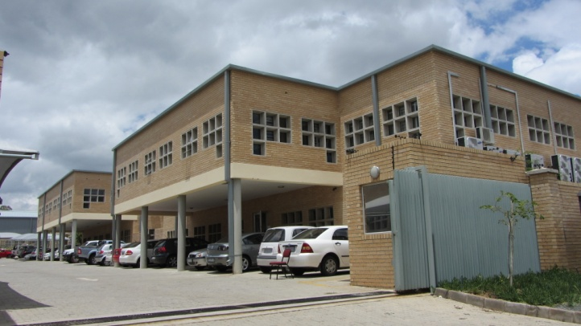
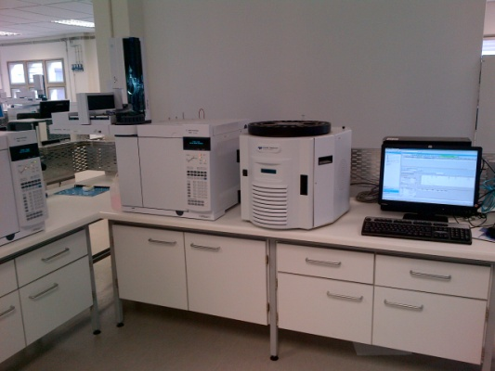
BUSINESS CONTINUITY PLAN- PHASE 2
NEW PERMANENT LOCATIONS NEED TO BE IDENTIFIED
Three newly constructed buildings not more than half a kilometre from the old facility identified.
Lease agreement signed.
Design plans and refurbishment of the facilities started end August 2011.
Microbiological, Occupational Hygiene, Environmental, and Water laboratories were scheduled to come on line before the completion of the new Pharmaceutical laboratories.
M&L move into the new Laboratories Mid October 2011.

Slide 15
BUSINESS CONTINUITY PLAN- PHASE 2
MCC Licence
It was the intention of M&L laboratory Services to obtain a MCC licence to carry out testing of act 101 registered pharmaceutical products
Initially at the Satellite Laboratory and ultimately at the new site
SANAS ISO 17025 Accreditation
It was the intentions of M&L laboratory services to have SANAS audit our new operation before the end of 2011 to have our previous accreditation reinstated.

Slide 16
BUSINESS CONTINUITY PLAN- PHASE 2
SANAS ISO 17025 Accreditation
Application for new site accreditation , 15th November2011
SANAS assessment carried out 14th and 15th December 2011.
M&L Response to non-conformances submitted 23rd January 2012.
SANAS Certificate issued 12th March 2012.

Slide 17
BUSINESS CONTINUITY PLAN- PHASE 2
MCC Licence New Facility
Application for the New Facility in Ormonde, licence was submitted on the 22nd December 2011
MCC inspection carried out 15th and 16th February 2012
M&L Response to findings submitted 16th March 2012
MCC Council Resolution 26th April 2012
MCC licence approves. Hard copy pending

Slide 18
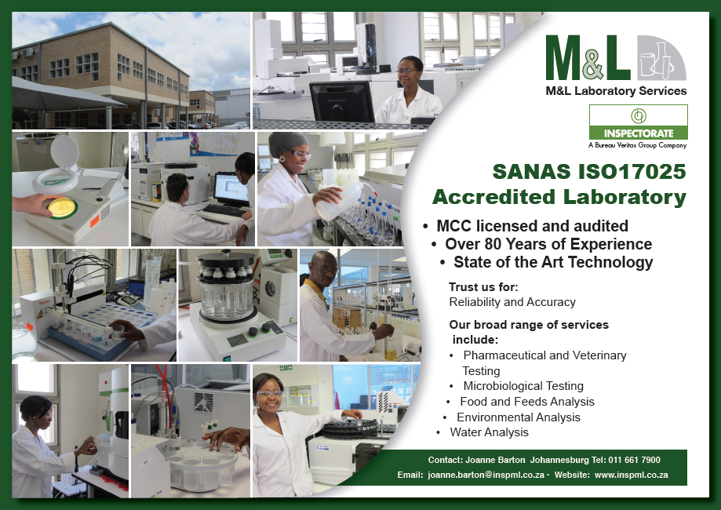


Slide 19
THANK YOU

